Slide 1
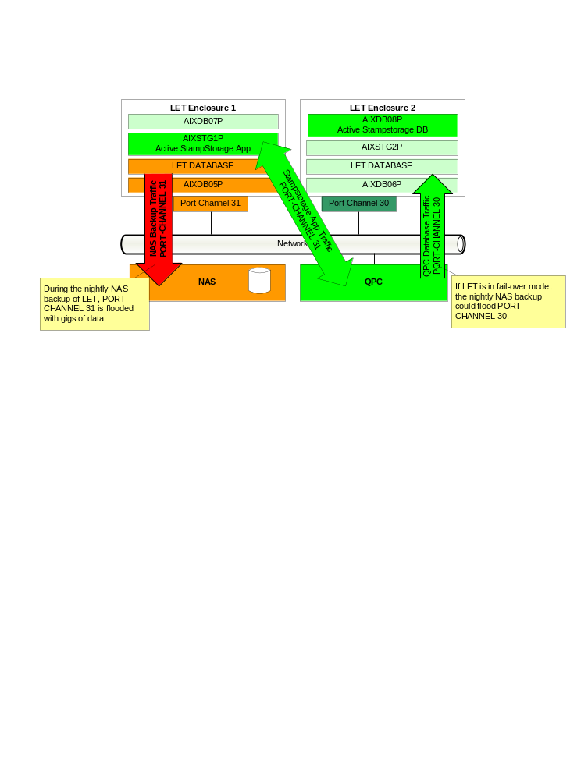
Dept
MFG/IT
IR #
1447866
OHCV Application Outage
Rev. 1 8/09 JS/DC
Phase 1
Completed By:
Adam Kendell Incident Date: 03/05/2012
Phase 2
Problem:
Stampstorage application experienced an outage from 3:08AM to 5:53AM 3/5/2012.
Background: Both LET Enclosures were set up with only one VLAN and port channel to reduce costs. A lack of end-to-end monitoring tools hampered diagnosis for over 4 months.
Root Cause:
Traffic on PORT-CHANNEL 31 on LET Enclosure 1 was at capacity due to an overly large LET backup.
Management Viewpoint:
The effected areas included LET, ELP VinStamp and OHCV Stampstorage. All programs running on LET Enclosure 1 would have experienced slow-downs.
Detailed Impact: Stampstorage experienced intermittent downtime from 3:08AM to 5:53AM. This caused side-panel production to use many manual processes to maintain production.
Line #
N/A
Shift
C
Plant:
MAP
Counter Measure Category | Countermeasure Description | Schedule | Who
Quick Fix |  | N/A | NA
TCM: |  | TBD | Mayank Deopa and Adam Kendell
PCM: |  | TBD | Mike Gilton and Gangaprasad Nagamalla
Identified Themes |  | TBD | TBD
The NAS backup operation that caused the issue had completed before the issue had been reported or discovered.
Moving the active instance of the application to AIXSTG2P that resides on LET Enclosure 2 will isolate the stampstorage application from the online LET NAS backup until PCM is implemented.
Isolate backup traffic on both LET Enclosures on a separate PORT-CHANNEL and VLAN.
Architecture best practices: Create separate VLANS for backup, development and production traffic

Slide 2
